Slide 1
Project Overview

Slide 2
Components working till now
Servo motor
Led
Buzzer
Ultrasonic sensor(connections)

Slide 3
Overview
The project is an object detection system that uses an ultrasonic sensor to figure out the proximity of any object within a certain range.
The range can be from 10 degrees to 180 degrees as a result of the sensor being mounted on an SG90 servo motor.
The detected object will be notified visually as well as with audio cues using a red and green led and a buzzer.
Furthermore, a radar-type system can be emulated on a computer marking the areas red where the object has been detected.
Till now, we have been successfully implementing the functionality of all the sensors individually and some of the sensors in common.
Moving forward, we plan to finish the building process in the next few weeks and proceed with testing, final code review, and bugs.

Slide 4
Hardware architecture
The hardware architecture for the object detection system using an ultrasonic sensor and SG90 servo motor would involve the following components:
BeagleBone Black: It would be the main microcontroller unit to control and coordinate the sensor and motor.
HC-SR04 Ultrasonic Sensor: It would be used to detect the proximity of any object within the specified range.
SG90 Servo Motor: It would be responsible for rotating the sensor to cover a range from 10 degrees to 180 degrees.
Red and Green LEDs: These would be used to provide visual cues to indicate the presence or absence of an object.
Buzzer: It would be used to provide audio cues to indicate the presence or absence of an object.
Breadboard, resistors, jump wires(male to male, female to male)
Computer(optional): It would be used to display a radar-like system, marking the areas red where the object has been detected.

Slide 5
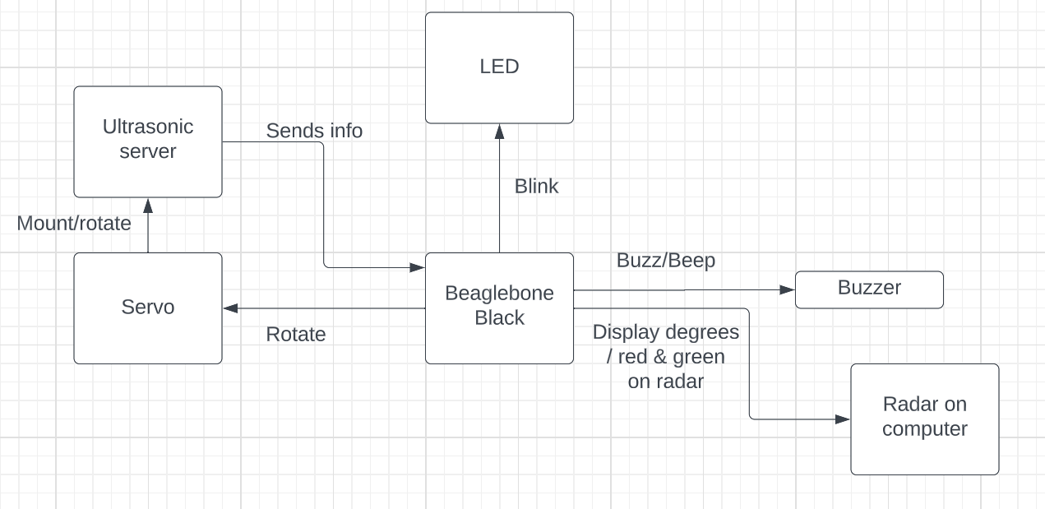

Slide 6
Detailed working on the software
Initialize the GPIO pins for the ultrasonic sensor, servo motor, red and green LED lights, and buzzer.
Start a loop that continuously moves the servo motor from 10 degrees to 180 degrees in increments of 10 degrees.
At each position of the servo motor, trigger the ultrasonic sensor and calculate the distance of the detected object.
Depending on the distance, turn on either the red LED (if the object is too close) or the green LED (if the object is within a safe distance).
Play a beep sound using the buzzer to indicate the presence of an object.
Send the data about the detected object to the computer via serial communication.
On the computer, a program reads the data and generates a graphical representation of the area being scanned by the ultrasonic sensor, marking the areas in red where an object has been detected.
The loop continues until it has completed the full 180 degrees rotation, and then it starts over again.

Slide 7
Design decision
Hardware decisions
The decision to use the HCSR04 sensor: The HCSR04 ultrasonic sensor was chosen due to its low cost, accuracy, and ease of use as compared to the sensor camera module which can be expensive and complicated to implement
The decision to use LEDs as a way of the visual indicator: simple red and green led are a universal signs of right and wrong and hence giving a visual indication using these color LEDs will be better as compared to text indicating the distance
the decision to use a buzzer: The buzzer gives audio cues to give people a sense of alarm or alert, making them instantly realize that something needs attention.
The decision to create modules: Working in modules gives the ease of managing software and makes it readable, easily accessible and to debug.
Servo motor: An SG90 servo motor was selected to allow for the sensor to sweep across a range of 10-180 degrees.
Programming language: C was chosen as the programming language due to its faster processing speed and vast use of interacting with hardware components.

Slide 8
Software architecture
The software for this project will be modularized with various modules performing various functions and integrating the output in a separate module. The various modules will be
Input/sensor module: this module takes the input from the ultrasonic sensor and passes it to the controller
motor module: this module will be in charge of rotating the servo motor at regular intervals from 0 degrees to 180 degrees
Computing module/object detection algorithm: this module takes the input from the sensor module and processes the data and makes decisions to be made for the output module
Visual/led module: this module controls the red and green LEDs and manages them based on the computational output from the computing module
Buzzer module: this module controls when the buzzer buzzes based on the output provided by the computational module
Radar module: this module will process the radar to be displayed on the computer screen based on the information provided by the sensors and the computational/object detection module

Slide 9
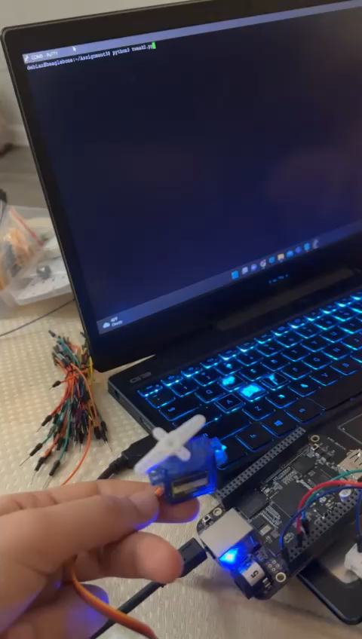
Demo of working
Fig 1: working of servo motor

Slide 10
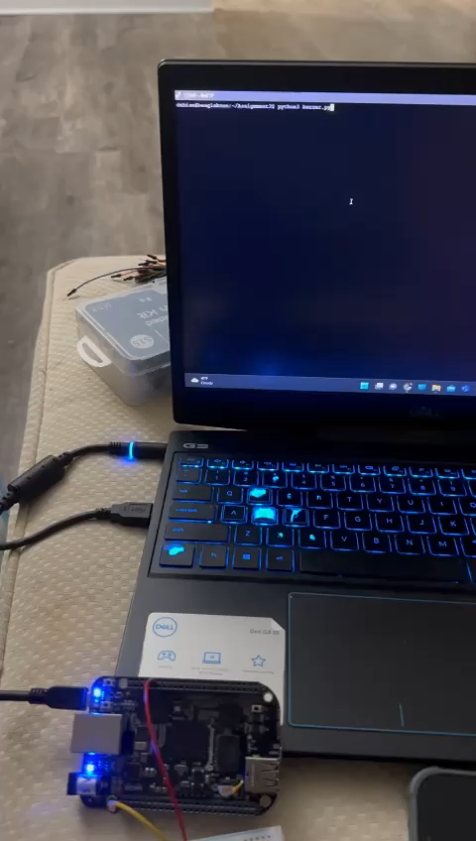
Fig 2: working of buzzer

Slide 11
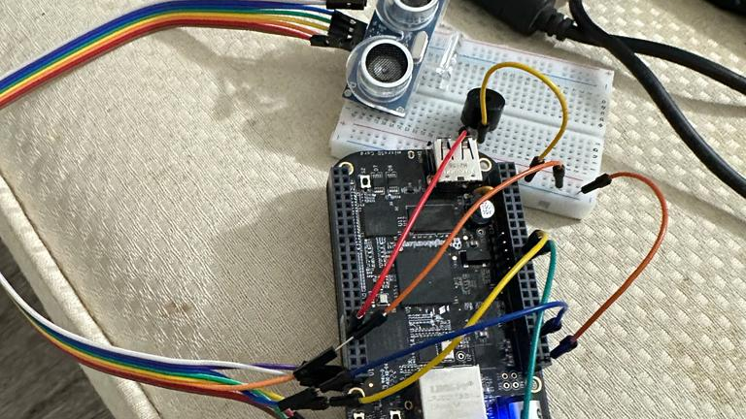
Fig 3: ultrasonic sensor connections

Slide 12
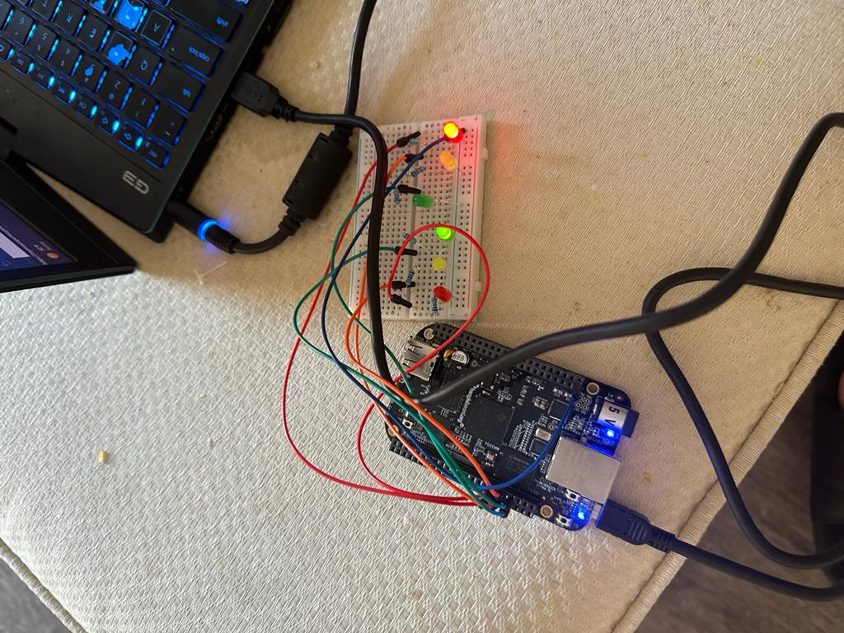
Fig 4: previously tested led connection

